Slide 1
SRG Unified Dashboard Demo

Slide 2
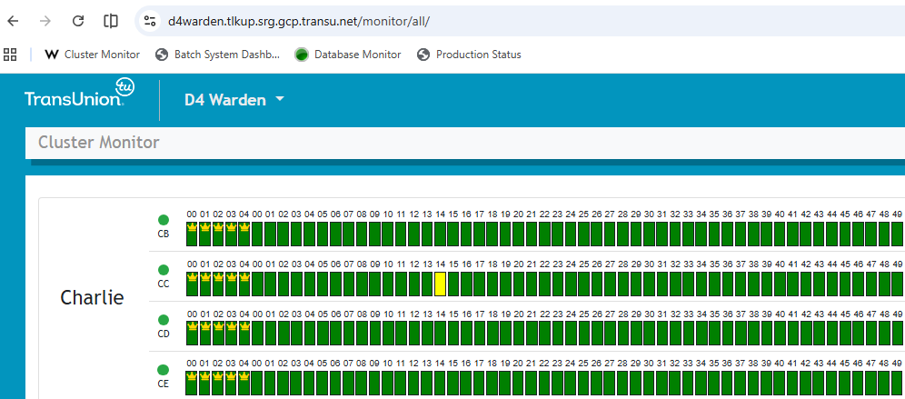
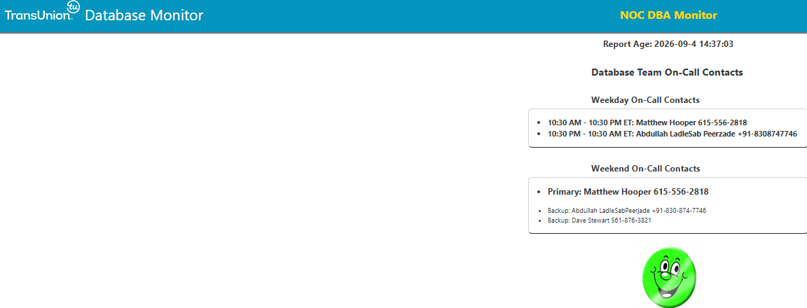
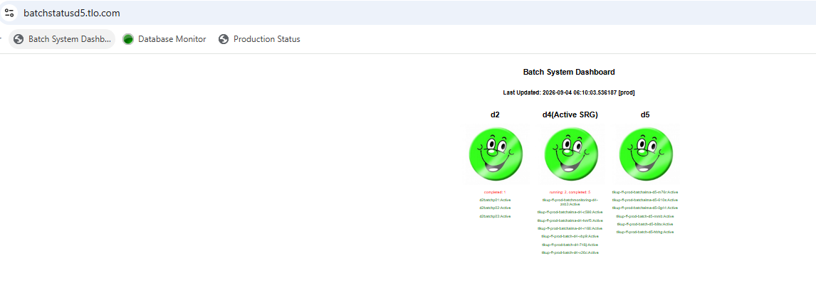

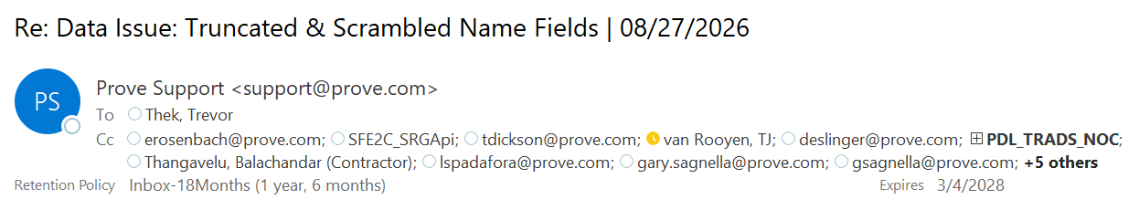


Traditional approach – Monitoring 4 different screens at a time
1. Dashboard of Cluster Monitor
2. Database Monitor
4. Mailbox monitoring for critical email aerts
3. Batch Monitor
Challenges :
Strict SLAs of Code Blue, Prove/Payphone alerts.
Eye on glass monitoring of multiple screens.
High risk of delaying the critical actions.

Slide 3
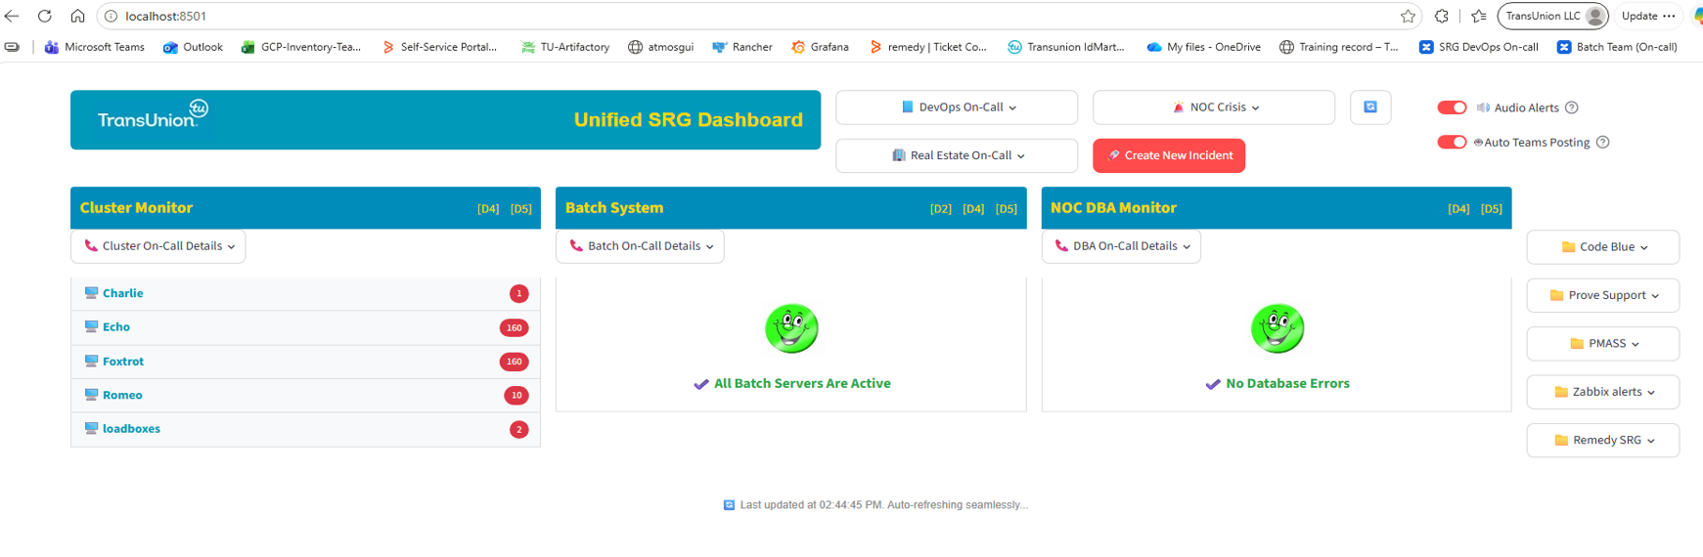
Improved approach – Unified SRG Dashboard
Cybage Monitoring team developed a single Dashboard – Single point of monitoring for all the alerts with added features
1st Dashboard
2nd Dashboard
3rd Dashboard
4th Dashboard
Features
All screens brought onto single dashboard.
This highlights only failures so quick to act on the alert.
Every new alerts pop up the notification as well and generate the system buzz.
On-call rosters integrated, so no need to visit confluences every time.
Draft readily available to post updates in the team's chat.
Tags respective on-call personnel on the team's channel.

Slide 4
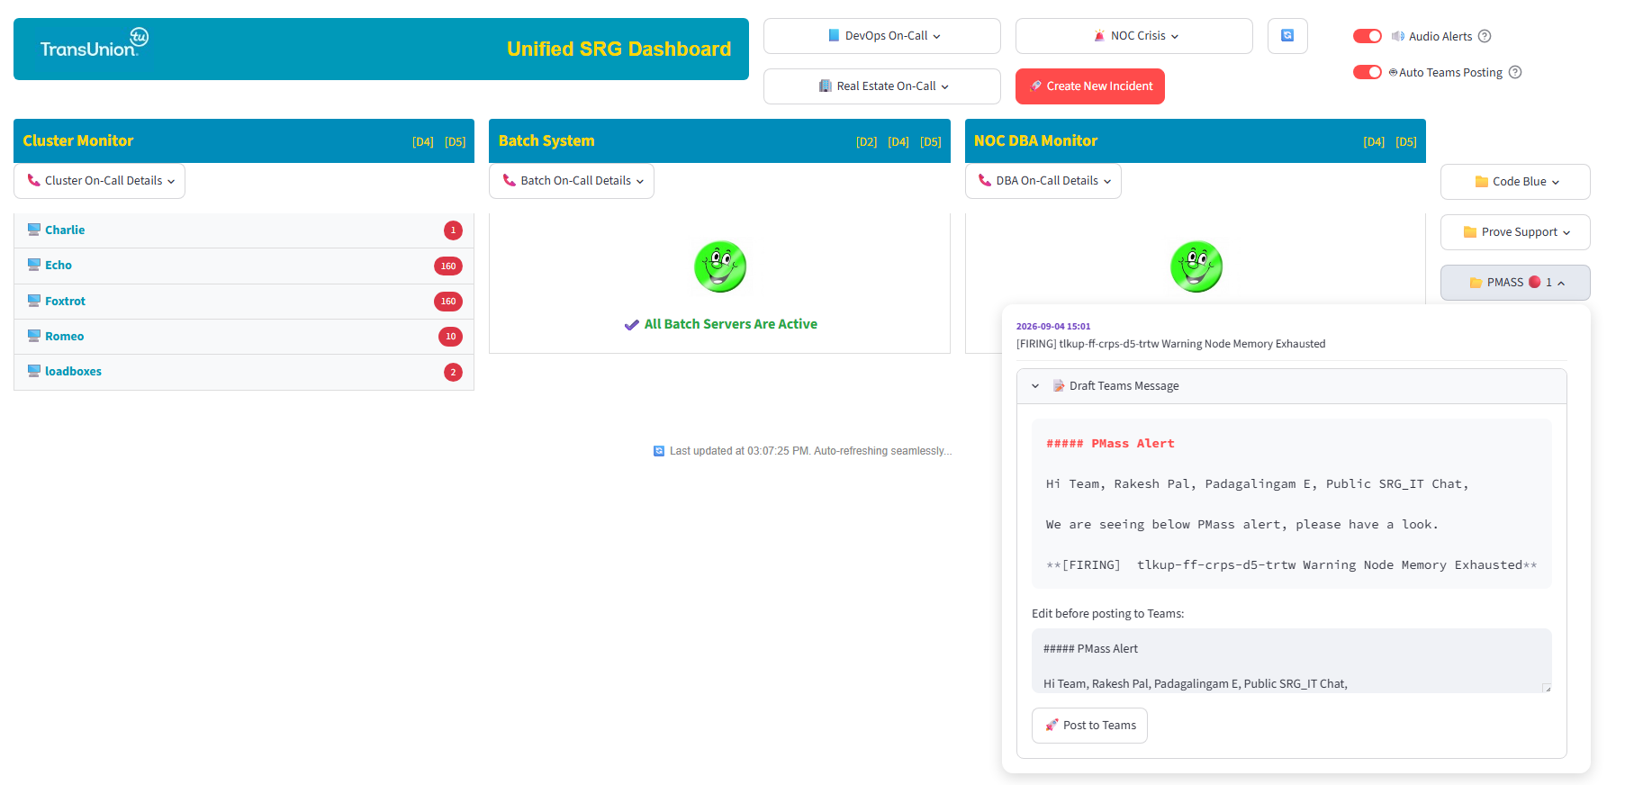
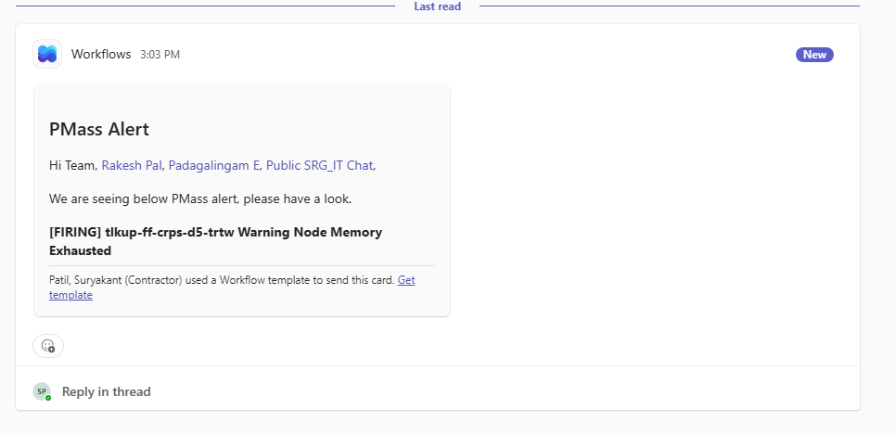
Future state - Complete automation
Features
Complete automation.
Auto message posting when alert is generated, tagging the on-call personnel.
Auto paging to respective teams if alert is not acknowledged.

Slide 5


Thank You!

